Slide 1
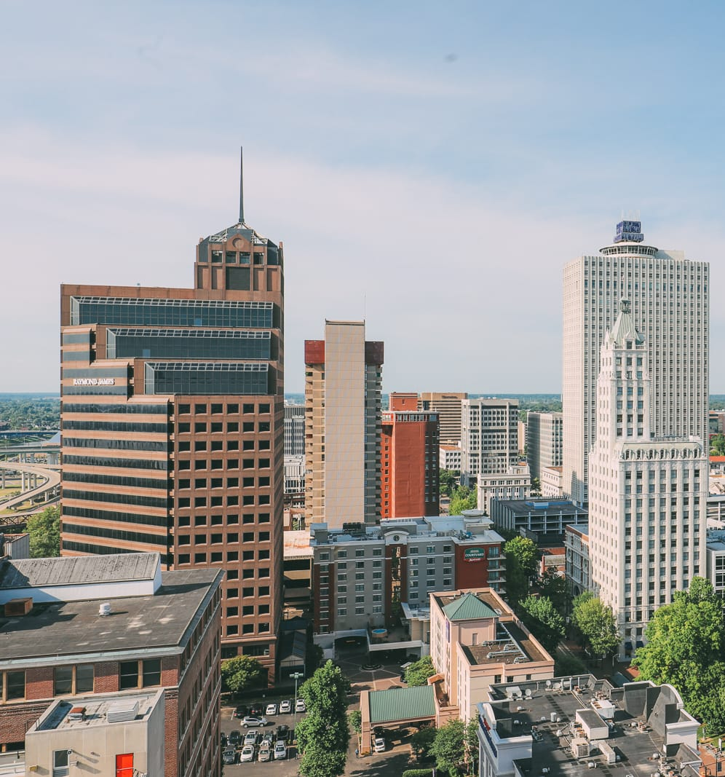
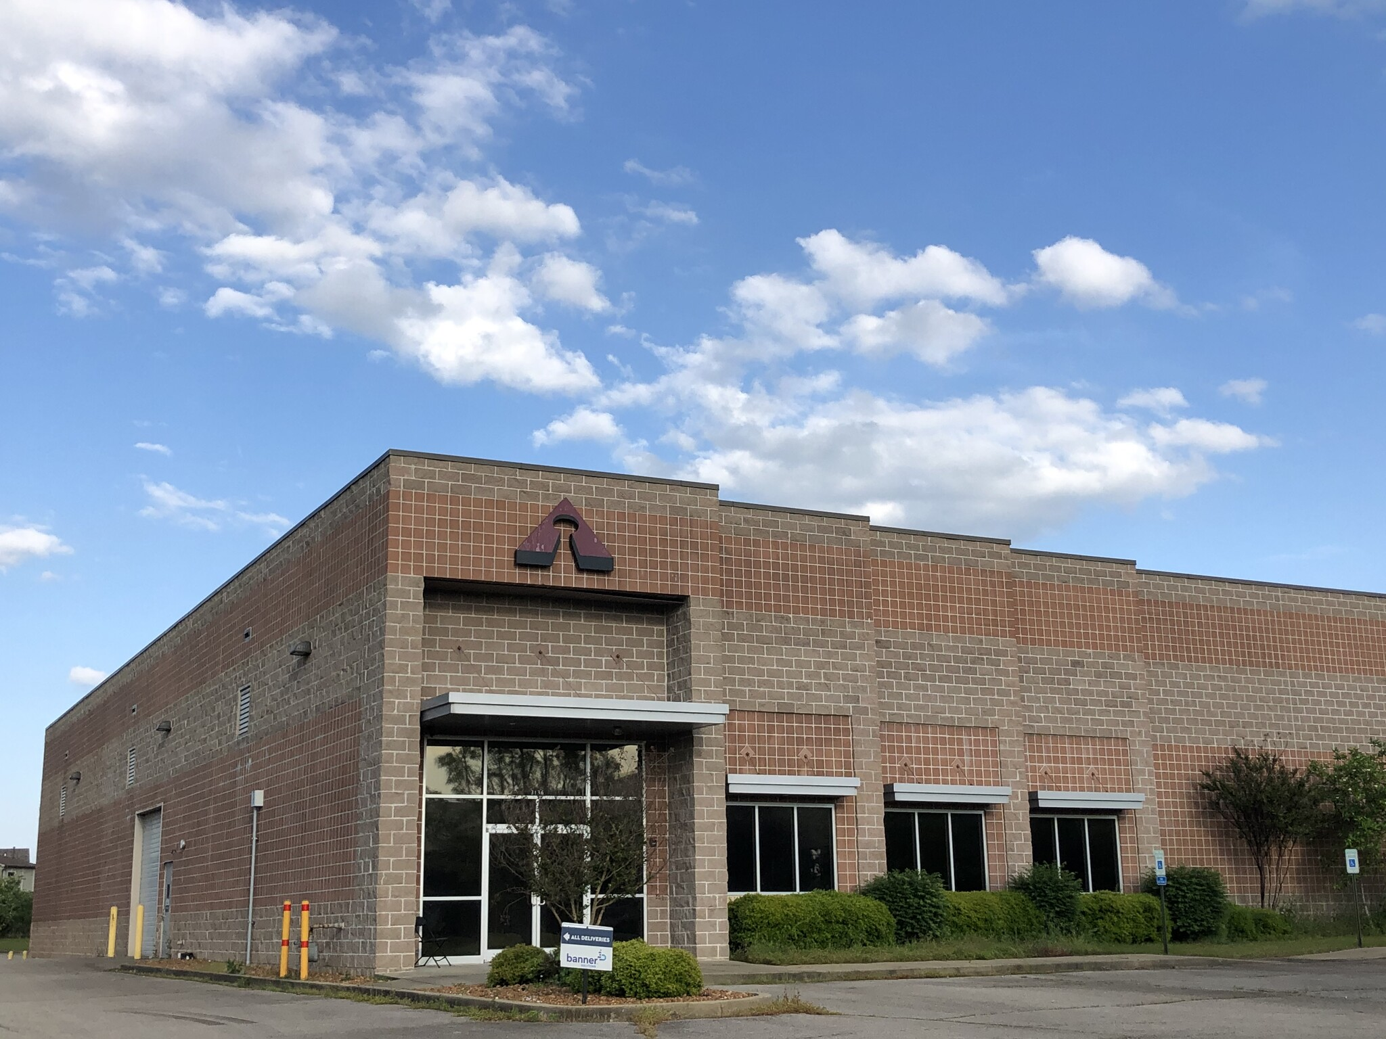
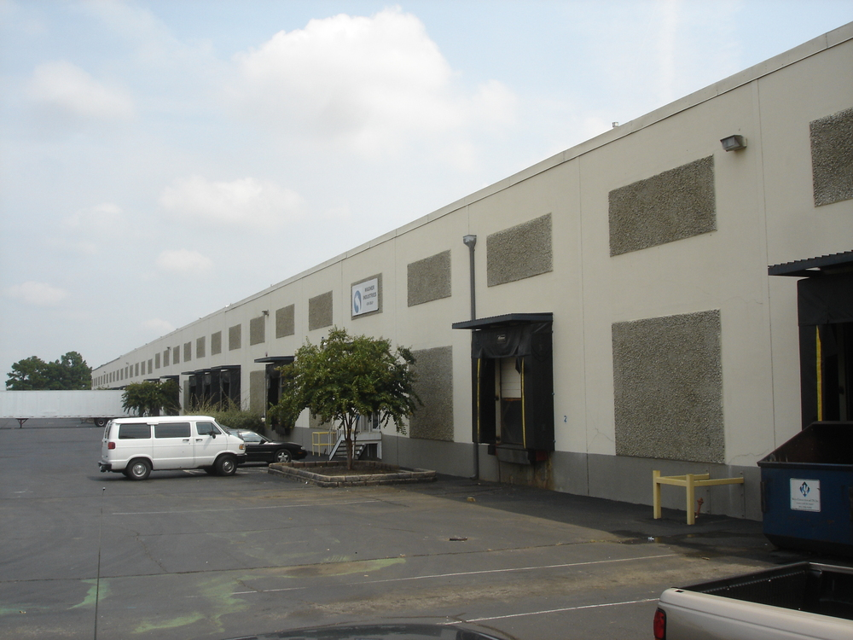
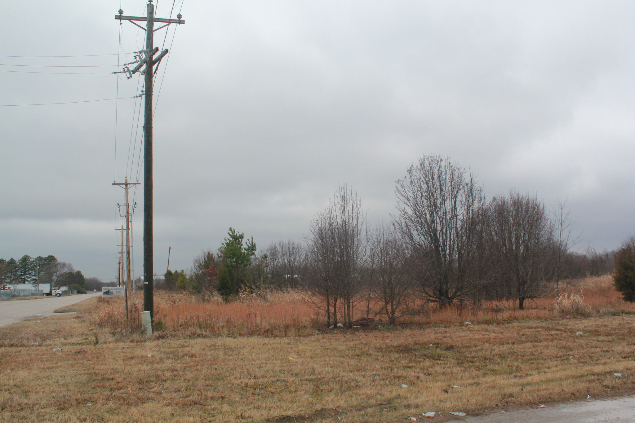
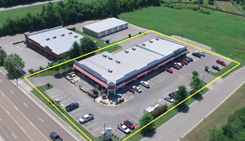
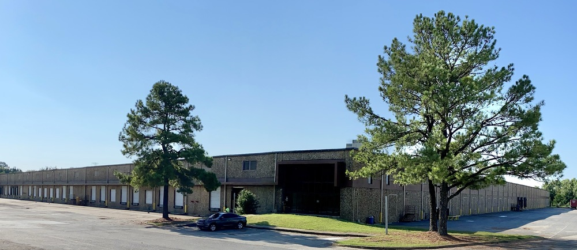
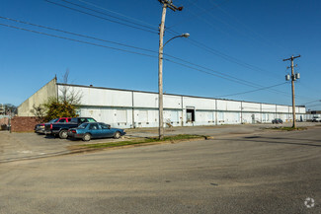
QUARTERLY REVIEW | Q2 2021
NOTABLE TRANSACTIONS
Industrial/Sale:
Henry Webb represented the seller & Brian Califf assisted the buyer.
3136 Ladurl Cove
15,876 SF
Industrial/Lease:
Hank Martin represented the buyer, Faropoint & Elliot Embry assisted in the lease. Brian Califf represented the seller, Trident Capital.
4290 Delp Street
297,216 SF
Land/Sale:
Daniel McPhail represented the buyer.
10955 Ridgeway Industrial Drive
8 Acres
Retail/Sale:
Daniel McPhail represented the seller.
7860 Highway 64, Oakland
15,000 SF
Industrial/Lease:
Hank Martin represented the owner, Olymbec &; Elliot Embry represented the tenant, War Logistics.
6125 E Shelby Drive
127,000 SF
Industrial/Sale & Lease:
Hank Martin & Brian Califf represented the seller. Henry Webb assisted the tenant, VF Pallets.
1655 Panama Street
95,000 SF
NAI Saig Company brokers win prestigious Pinnacle Awards in Commercial Real Estate
Just recently, the 2020 Pinnacle Awards were presented to the top brokers in commercial real estate. The Pinnacle
Awards were established in 2002 to spotlight achievements of commercial real estate leaders in Memphis,
Tennessee. While NAI Saig Company is small compared to other commercial firms in the area, the brokers
continuously do as many transactions as those larger companies. The brokers are proud of the fact that they can
compete in a highly-competitive market yet keep the intimate feel of the family-owned firm. The yearly volume
is unmatched in the city for a company of its size.
Brian Califf, CCIM, won the Industrial & Retail Sales Broker of the Year with $214 M in total
volume. He also won the TOP 25 Broker Award.
Hank Martin, SIOR, CCIM was awarded TOP 25 Broker Award.
As Managing Broker, Hank’s total volume in 2020 was $128 M.
Elliot Embry, SIOR, received the Grit & Grind Award which is given to the
broker with the most transactions. He also won the TOP 25 Broker Award
with $88 M in volume.
Daniel McPhail and Henry Webb were named to the
Pinnacle Producers Club.
6263 Poplar Avenue, Suite 150
Memphis, TN 38119
(901) 526-3100 | saigcompany.com

Slide 2
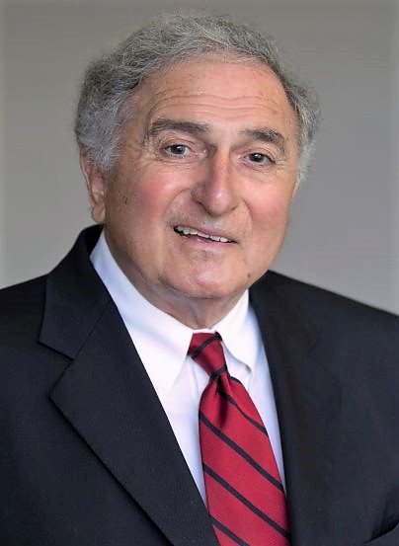
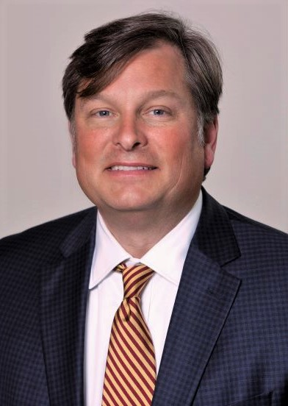
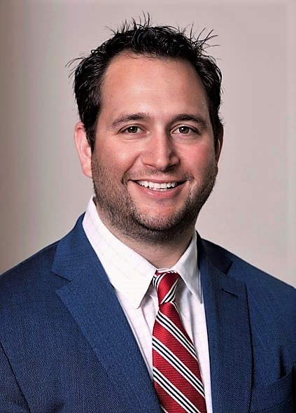
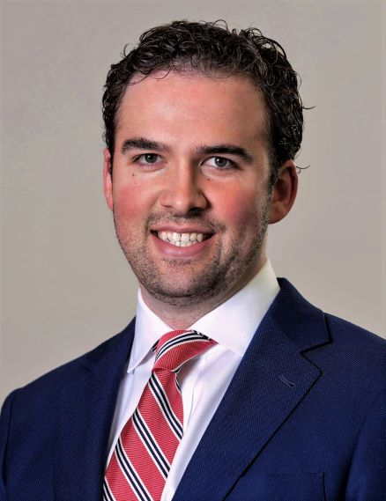
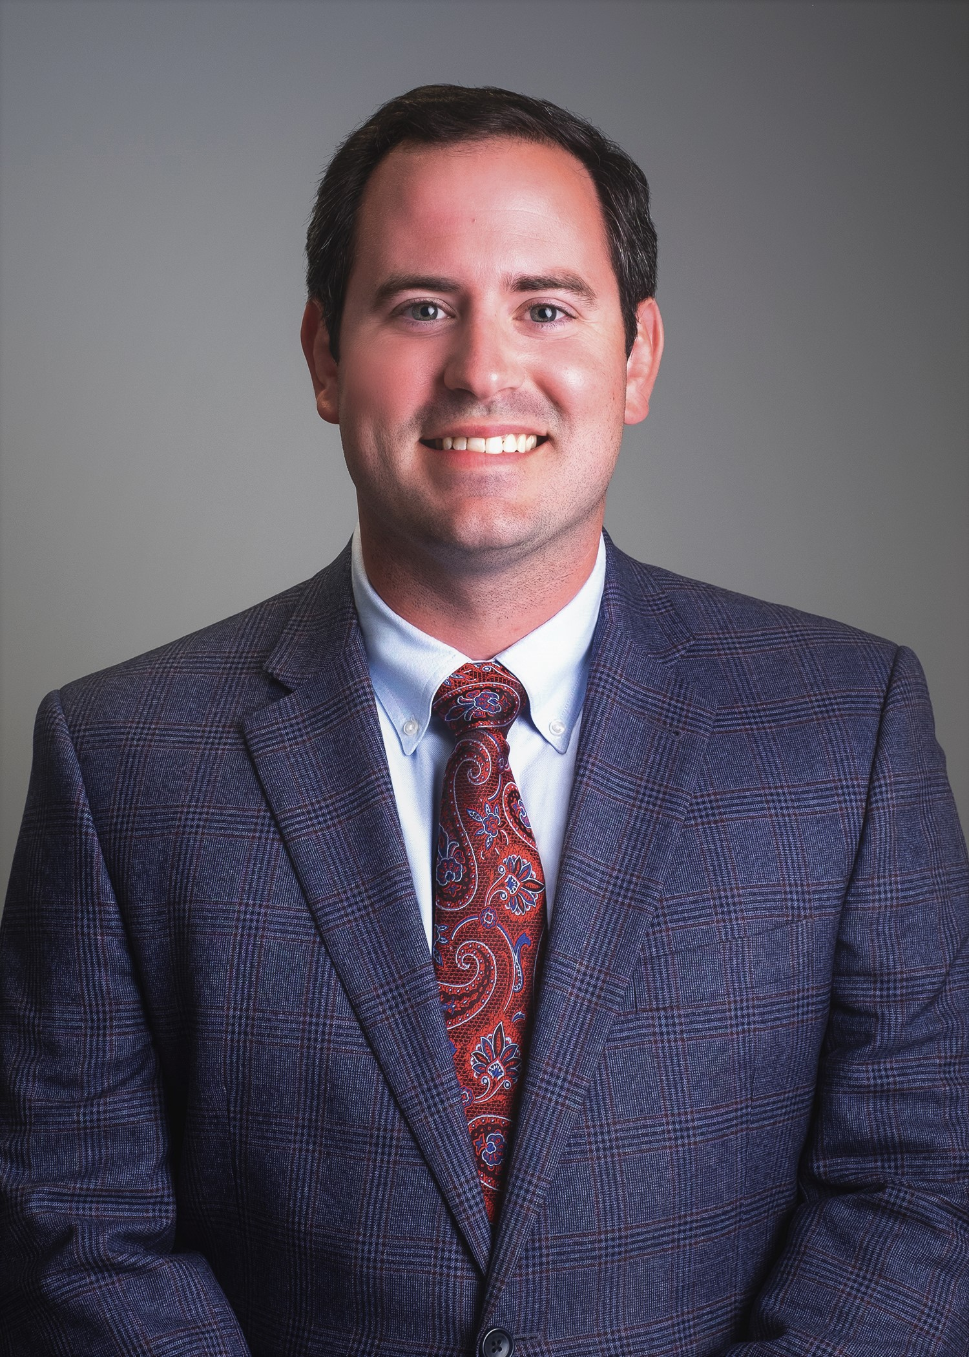
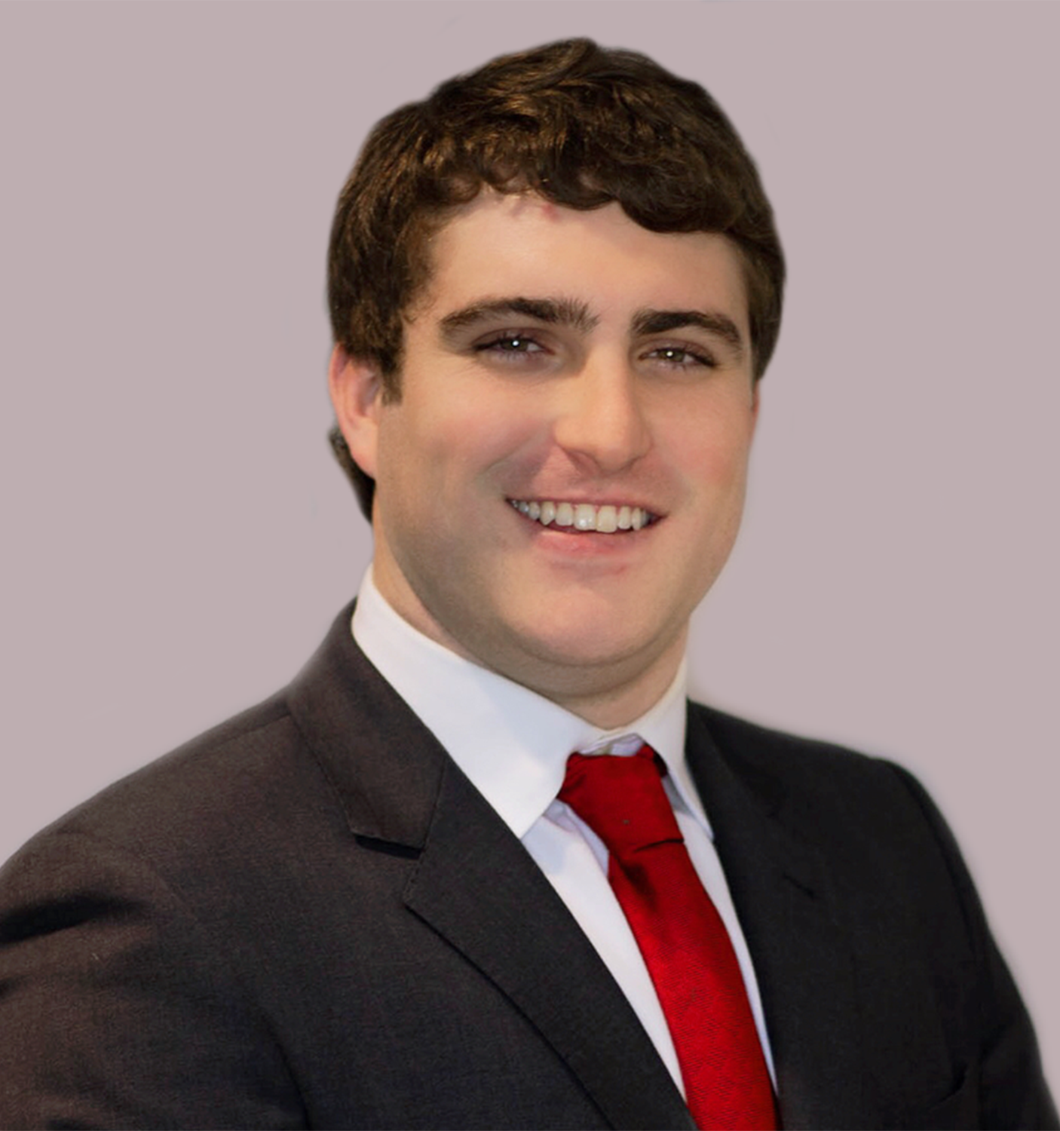
NAI Saig Company is the market-leading, full-service commercial real estate brokerage firm. Our operation in Memphis and the Mid-South began in 1963. We provide a full range of services in industrial/office/retail/land representation, tenant representation, and investment brokerage. Our full capability is by design. Our wide array of services coupled with our depth of experience provide uniquely tailored results for our clients.
INDUSTRIAL TRENDS
OFFICE TRENDS
RETAIL TRENDS
Inventory SF 296 M
Market Rent/SF $4.00
Annual Rent Growth 5%
12 Mo Net Absorp SF 12.1 M
Market Sale Price/ SF $43
Vacancy Rate 5.6%
12 Mo Sales Vol $614 M
Source: Costar News
Inventory SF 56 M
Market Rent/SF $19.39
Annual Rent Growth 1.0%
12 Mo Net Absorp SF (475K)
Market Sale Price/ SF $131
Vacancy Rate 10.8%
12 Mo Sales Vol $252 M
Inventory SF 90.6 M
Market Rent/SF $13.91
Annual Rent Growth 1.1%
12 Mo Net Absorp SF 54.7 K
Market Sale Price/ SF $120
Vacancy Rate 4.5%
12 Mo Sales Vol $342 M
MARKET REVIEW
Walgreens chose Memphis to implement a new model to increase speed of packages sent to stores and consumers’ homes. A fulfillment center with state-of-the-art technology will require 103,00 SF of warehouse space on Tchulatech Drive. The new delivery system will lower costs related to filling customer orders, improving customer experience, and expanding delivery services. Source: Daily Memphian
A new solar farm near Millington, just North of Memphis, will support Facebook data center operations in the Tennessee Valley area. Facebook will partner with renewal energy company, RWE Renewables, to build a $140 million, 150-megawatt solar facility. Source: Daily Memphian
A Memphis-based multimedia company plans an 85-acre film studio lot in Whitehaven, complete with sound stages, commissary, editing facilities, recording studio, a warehouse for building sets, and a hotel for out-of-town production crews. An application was filed with the Land Use Control Board for a planned development on property near the southwest corner of Elvis Presley Boulevard and Holmes Road.
Source: Daily Memphian
A large, mixed-use development-hotel, apartments, office space and parking structure-is proposed for a prominent East Memphis property near the University of Memphis at the corner of Central and Highland. Proposed is a seven-story, 115-room hotel, capped with a rooftop restaurant and bar. Another structure will hold a parking garage, office space and courtyard, apartments and a pool terrace.
The Memphis Fairgrounds will become Liberty Park: a 277,000-square-foot Memphis Sports and Events Center that will be for public use and for the use of youth sports tournaments. An area near Central Avenue will include a large, mixed-use development to house hotels, restaurants and apartments.
Source: Daily Memphian
Eddie Saig, SIOR, CRE
Laura Saig Martin,
Principal Broker
Hank Martin SIOR, CCIM
Brian Califf, CCIM
Elliot Embry SIOR
Daniel McPhail
Henry Webb
Amy Farris
OWNER/INVESTOR SERVICES
OUR SERVICES
DEVELOPER SERVICES
Consultancy | Marketing | Investment
Management | Valuation & Advisory
Acquisition & Dispositions
Sustainability & Environmental
TENANTS/OCCUPIERS
Consultancy | Marketing | Investment
Marketing | Management
Valuation & Advisory
Sustainability & Environmental
Consultancy | Valuation & Advisory
Corporate Services | Tenant Representation

